Slide 1
Exporter Registration Procedures
Step by Step Guide to Exporting Workshop July 7, 2016
JAMPRO
Peter Blake

Slide 2
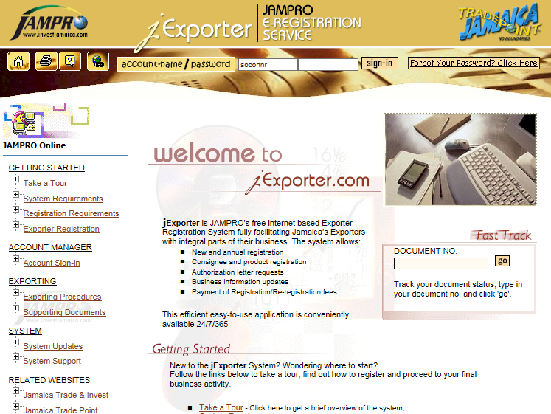

Slide 3
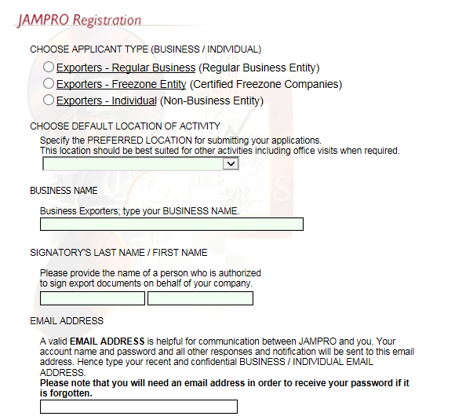

Slide 4
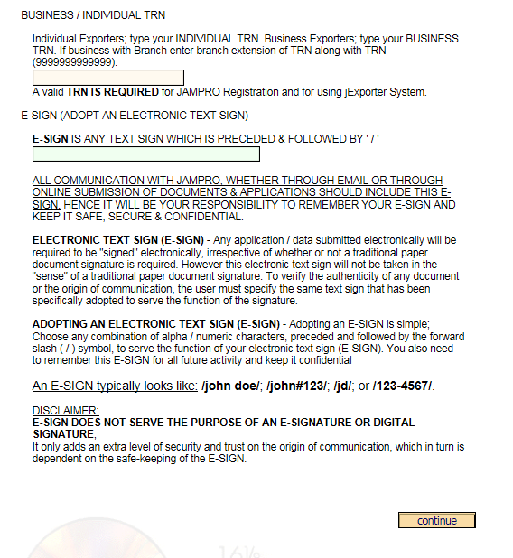

Slide 5
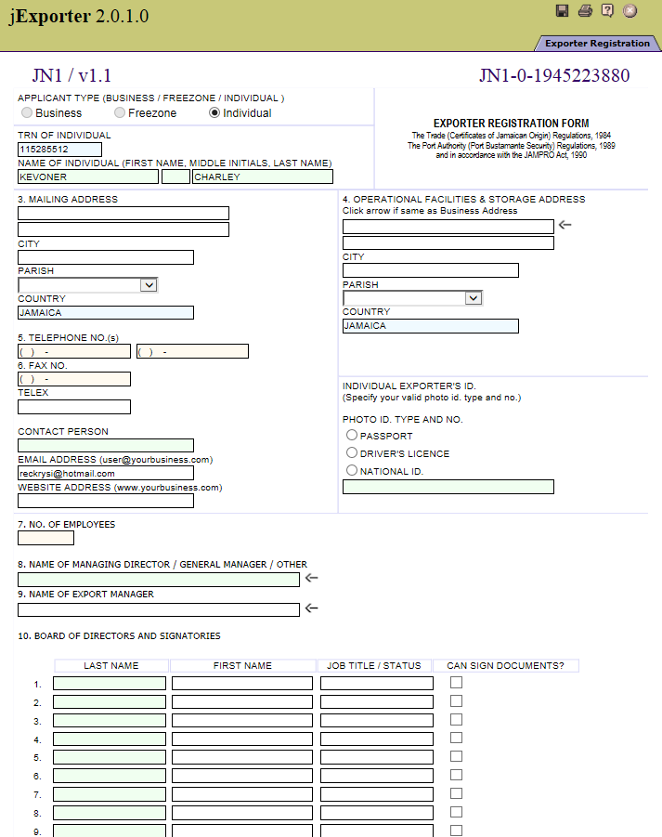

Slide 6
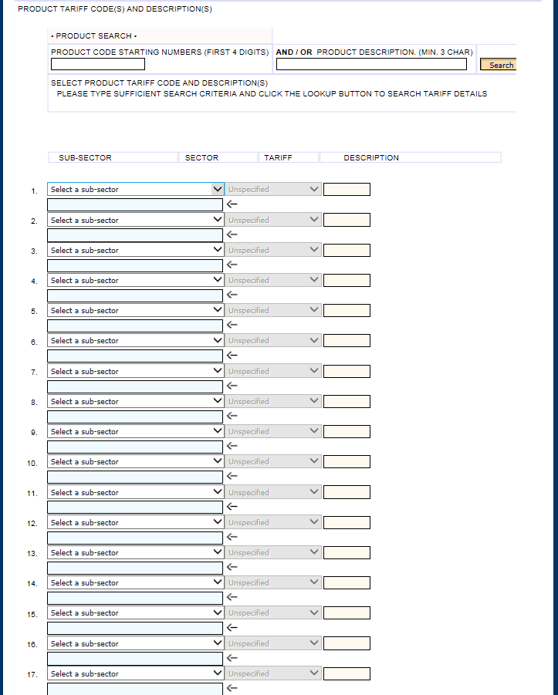

Slide 7
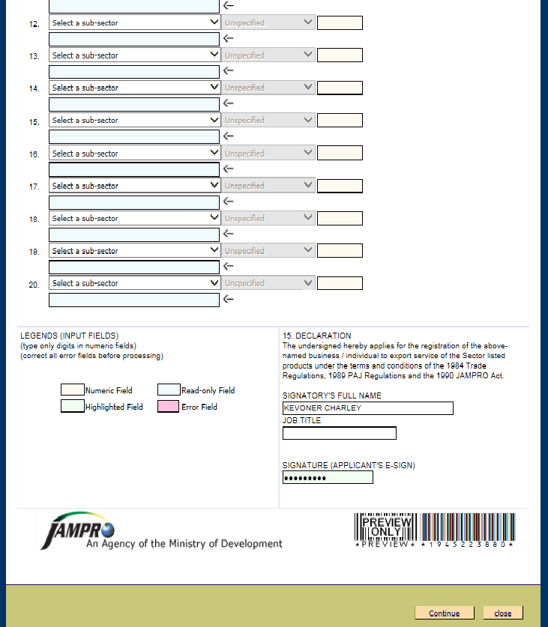

Slide 8
For the Registration of a Business or Company
Taxpayer Registration Number (TRN)
Copy of Certificate of Incorporation OR
Copy of Certificate of Business Name received from the Companies Office of Jamaica

Slide 9
For the Registration of an Individual
Taxpayer Registration Number (TRN)
Proof of valid Jamaica Identification (passport, driver’s license or National ID Card)
One (1) Passport-sized Photograph

Slide 10
An authorization letter from the Plant Quarantine Division of the Ministry of Agriculture, stating that your packinghouse for the fresh produce has been inspected and certified.

Slide 11
Proof of registration of your factory from the bureau of Standards (BSJ) if the product you intend to export falls under the BSJs prescribed processed food list.

Slide 12
Proof of certification of your factory from the Veterinary Services Division of the Ministry of Agriculture, for the exportation of aquaculture, inland and marine products and by-products.

Slide 13
New Company/Business/Individual | J$3500.00
Re-registering Company/Business/Individual (Annual fee) | J$3000.00
All Freezone Companies | US$350

Slide 14
Upon submission of all necessary documents, a JAMPRO officer makes a verification visit to the premises of the company/business/ individual. Thereafter, the application is reviewed to determine eligibility for registration.

